Slide 1

CSE310: Programming in Java
Topic: Variables & their Scope

Slide 2
Outlines
[Expected Time: 1 Hours]
Variables and their Scope
  Local Variable
  Instance Variable
  Class Variable

Slide 4
Variables
Variable are the data members or the fields defined inside a class.
There are three types of variables:
  Local Variable
  Instance Variable
  Class Variable

Slide 5
Local Variable
Local variables are those data members which are declared in methods, constructors, or blocks.
They are created only when the method, constructor or block is executed and destroyed as soon as the execution of that block is completed.
So the visibility of local variables is inside the block only, they can’t be accessed outside the scope of that block.

Slide 6
Important
Access modifiers are NOT ALLOWED with local variables.
Local variables are created in STACK.
Default value is NOT ASSIGNED to the local variables in Java.

Slide 7
Instance Variables
Variables which are declared in a class, but outside a method, constructor or any block are known as instance variables.
They are created inside the object in heap.
Each object has its own set of instance variables and they can be accessed/modified separately using object reference.

Slide 8
Instance variables are created when an object is created with the use of the 'new' keyword and destroyed when the object is destroyed.
Access modifiers can be used with instance variables.
Instance variables have default values.
For numbers the default value is 0,
for Booleans it is false
and for object references it is null.

Slide 9
Class Variable
Class variables are also known as static variables.
Variable which are declared in a class, but outside a method, constructor or a block and qualified with ‘static’ keyword are known as class variables.
Only one copy of each class variable is created, regardless of how many objects are created from it.
Static variables can be accessed by calling with the class name.
ClassName.VariableName

Slide 10
Static variables are created with the start of execution of a program and destroyed when the program terminates.
Default values are same as instance variables.
A public static final variable behaves as a CONSTANT in Java.
Static variables can be initialized using static block also.

Slide 11


Slide 12
Variable Initialization
Local variables must be initialized explicitly by the programmer as the default values are not assigned to them where as the instance variables and static variables are assigned default values if they are not assigned values at the time of declaration.

Slide 13
Brainstorming 1
What will be the output of the following Program?
class VariableDemo
{
public static void main(String [] rk)
{
public int x = 10;
System.out.print(x);
}
}

Slide 14
Brainstorming 2
What will be the output of the following Program?
class VariableDemo
{
static int x;
public static void main(String [] rk)
{
int x;
System.out.print(x);
}
}

Slide 15
Brainstorming 3
What will be the output of the following Program?
class VariableDemo
{
static int x;
public static void main(String [] rk)
{
int x;
System.out.print(VariableDemo.x);
}
}

Slide 16
Which of the following is INCORRECT header for the main method in java?
A. public static void main(String [] arg)
B. static public void main(String arg [])
C. public static void main(String...arg)
D. None of These

Slide 17
Which of the following is NOT a feature of Java?
A. secure B. platform-dependent
C. robust D. multi-threaded

Slide 18
Which of the following statement is TRUE about the following class?
class A{}
A. It can be saved in a file named as B.java and compiled using command javac B.java
B. It can be saved only with name A.java and compiled using command javac A.java
C. It can not be instantiated.
D. None of These

Slide 19
Which of the following statement is TRUE about the following class?
class A{}
A. Class will not compile
B. Class will compile but can not be executed directly.
C. Instance of A CAN NOT be created.
D. Both B & C

Slide 20
Which of the following statement(s) is/are correct?
A. Java is portable and platform-dependent.
B. Java was invented by James Gosling.
C. Java uses Interpreter for execution of program.
D. Both B & C.

Slide 21
Which of the following is full form of "JDK" and "JVM"?
A. Java Deployment Kit, Java Virtual Mail
B. Java Distribution Kit, Java Virtual Machine
C. Java Development Kit, Java Vital Machine
D. None of These

Slide 22
In order for a java source code file, containing the public class Test, to successfully compile, which of the following must be true?
A. It must have only one class in it.
B. It must be named Test.java.
C. It must import java.lang package.
D. Both A & B

Slide 23
The following class is saved in a file named as Hello.java. Which of the following is TRUE about it?
public class A{}
A. It can be compiled using command javac A.java
B. It will be compiled using command javac A.java
C. It must be saved in a file named as A.java, otherwise it will not compile.
D. None of These

Slide 24
All the tools like javac. java etc available in _____.
A. java --> jdk --> bin
B. java --> jre --> bin
C. java --> jdk --> jre --> bin
D. java --> jdk --> tools --> bin

Slide 25
All the objects in Java are created inside ______ and local variable in ______.
A. Class Area, Heap
B. Heap, Class Area
C. Heap, Stack
D. Class Area, Stack

Slide 26
Which of the following is the minimum requirement for executing a java Program?
A. JDK B. JVM
C. JRE D. Both JDK and JRE

Slide 27
class Demo{
public static void main(String args[]){
Student s1 = new Student();
s1.showData();
Student s2 = new Student();
s2.showData();
//Student.b++;
//s1.showData();
}
}
class Student {
int a; //initialized to zero
static int b; //initialized to zero only when
class is loaded not for each object created.
public void showData(){
a++;
b++;
System.out.println("Value of a = "+a);
System.out.println("Value of b = "+b);
}
}

Slide 28
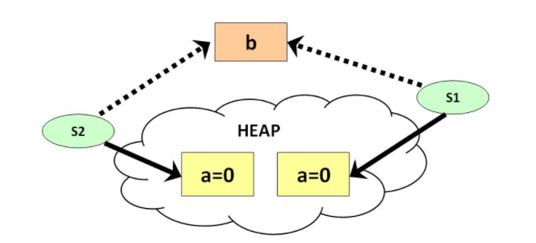

Slide 29


Slide 30
print()
print() method in Java is used to display a text on the console. This text is passed as the parameter to this method in the form of String.
This method prints the text on the console and the cursor remains at the end of the text at the console. The next printing takes place from just here.

Slide 31
void print(boolean b) – Prints a boolean value.
void print(char c) – Prints a character.
void print(char[] s) – Prints an array of characters.

Slide 32
void print(double d) – Prints a double-precision floating-point number.
void print(float f) – Prints a floating-point number.
void print(int i) – Prints an integer.
void print(long l) – Prints a long integer.
void print(Object obj) – Prints an object.
void print(String s) – Prints a string.

Slide 33
println()
println() method in Java is also used to display a text on the console. This text is passed as the parameter to this method in the form of String. This method prints the text on the console and the cursor remains at the start of the next line at the console. The next printing takes place from next line.

Slide 34
void println() – Terminates the current line by writing the line separator string.
void println(boolean x) – Prints a boolean and then terminate the line.
void println(char x) – Prints a character and then terminate the line.
void println(char[] x) – Prints an array of characters and then terminate the line.
void println(double x) – Prints a double and then terminate the line.
void println(float x) – Prints a float and then terminate the line.
void println(int x) – Prints an integer and then terminate the line.
void println(long x) – Prints a long and then terminate the line.
void println(Object x) – Prints an Object and then terminate the line.
void println(String x) – Prints a String and then terminate the line.

Slide 35
Formatted output in Java
It is essential to print the output in a given specified format. Most users are familiar with printf function in C.
Let us see discuss how we can format the output in Java:

Slide 37
Data Types
Java defines eight primitive types of data: byte , short, int, long , char , float, double, and boolean.
These can be put in four groups:
  Integers: This group includes byte , short, int, and long, which are for whole-valued signed numbers.
  Floating-point numbers: This group includes float and double, which represent numbers with fractional precision.
  Characters: This group includes char , which represents symbols in a character set, like letters and numbers.
  Boolean: This group includes boolean , which is a special type for representing true/false values.

Slide 38
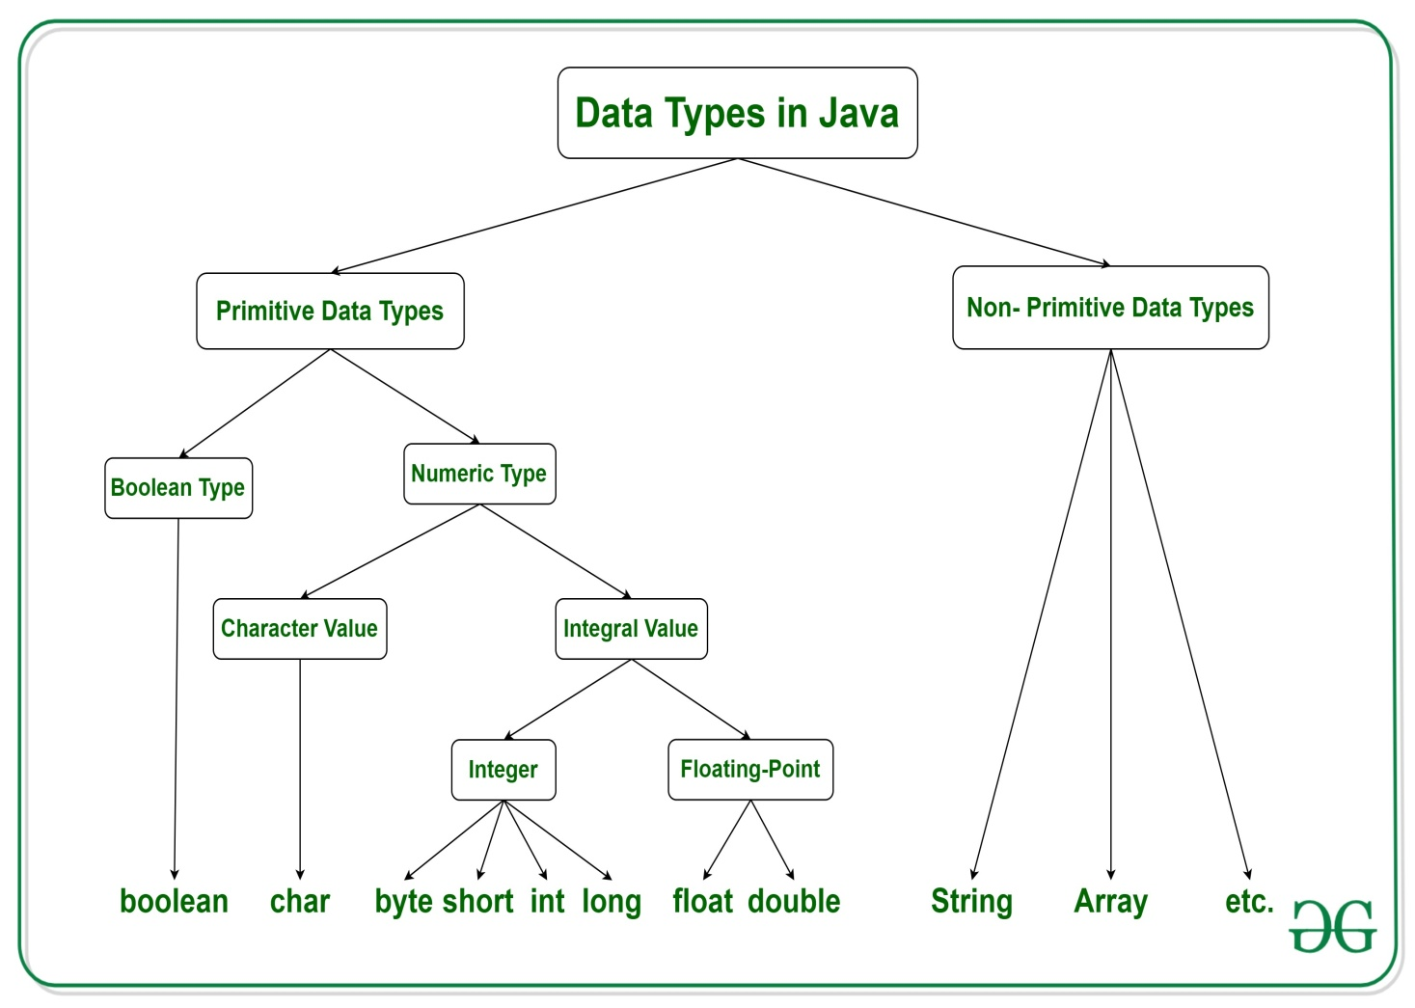

Slide 39
Non-primitive data types are called reference types because they refer to objects.
The main difference between primitive and non-primitive data types are:
Primitive types are predefined (already defined) in Java. Non-primitive types are created by the programmer and is not defined by Java (except for String).
Non-primitive types can be used to call methods to perform certain operations, while primitive types cannot.
A primitive type has always a value, while non-primitive types can be null.
A primitive type starts with a lowercase letter, while non-primitive types starts with an uppercase letter.
The size of a primitive type depends on the data type, while non-primitive types have all the same size.

Slide 40
Name, width and range of
Data Types
Name | Width | Range
byte | 8 | –128 to 127
short | 16 | –32,768 to 32,767
int | 32 | –2,147,483,648 to 2,147,483,647
long | 64 | –9,223,372,036,854,775,808 to 9,223,372,036,854,775,807
float | 32 | 1.4e–045 to 3.4e+038
double | 64 | 4.9e–324 to 1.8e+308
char | 16 | 0 to 65,536
Boolean | true or false

Slide 41
Variables
The variable is the basic unit of storage in a Java program.
A variable is defined by the combination of an identifier, a type, and an optional initializer.
Declaring a Variable:
  In Java, all variables must be declared before they can be used. The basic form of a variable declaration is shown here:
  type identifier [ = value][, identifier [= value] ...] ;

Slide 42
Here are several examples of variable declarations of various types. Note that some include an initialization.
  int a, b, c; // declares three ints, a, b, and c.
  int d = 3, e, f = 5; // declares three more ints,
  // initializing d and f.
  byte z = 22; // initializes z.
  double pi = 3.14159; // declares an approximation of // pi.
  char x = 'x'; // the variable x has the value 'x'.

Slide 43
Dynamic Initialization: Although the preceding examples have used only constants as initializers, Java allows variables to be initialized dynamically, using any expression valid at the time the variable is declared.
For example, here is a short program that computes the length of the hypotenuse of a right triangle given the lengths of its two opposing sides:
  // Demonstrate dynamic initialization.
  class DynInit {
  public static void main(String args[]) {
  double a = 3.0, b = 4.0;
  // c is dynamically initialized
  double c = Math.sqrt(a * a + b * b);
  System.out.println("Hypotenuse is " + c);
  }
  }

